Slide 1



Subtopic 1 - Place value and ordering integers and decimals
LEARNING OUTCOME: To understand how to order integers.
Objectives:
Keywords:
Integer
Place Value
Ascending
Descending
To order integers.
To order decimals
To order directed numbers
To solve problems involving ordering integers.
Definition
Characteristics
All integers which appear to the right of the 0 on a number line.
Greater than 0.
The larger integer means that the number is larger.
Examples
Positive Integers
Converting a percentage to a decimal – Examples
These numbers are all positive and all integers.
Non - Examples
$$−4$$
$$1.5$$
$$\frac{3}{4}$$
4
13
126
Ordering integers without a number line
For the following questions, list the numbers in Ascending order.
Steps | 872, 802, 870, 780, 827 | 542, 412, 585, 591, 572 | 333, 395, 299, 313, 329
Look at the place value of the leftmost digit. Write down the number with the largest place value.
If any have the same place value, look at the digit to the right and write down the number with the lowest value. Repeat until all numbers have been ordered.
Example 1 - I do…
Example 2 – We do…
Example 3 – You do…
For the following questions, list the numbers in Descending order.
Steps | 562, 56, 5620, 526, 5260 | 7312, 7321, 732, 73, 723 | 32, 372, 3372, 3732, 327
Look at the place value of the leftmost digit. Write down the number with the smallest place value.
If any have the same place value, look at the digit to the right and write down the number with the highest value. Repeat until all numbers have been ordered.
Example 4 - I do…
Example 5 – We do…
Example 6 – You do…
Notes:
PRESENTATION AND LESSON STRUCTURE????

Slide 2
Independent Practice
1. For the following questions, list the numbers in ascending order.
a) 8, 5, 9, 10, 2
b) 11, 20, 9, 15, 14, 3
c) 40, 60, 20, 30, 90, 10
d) 83, 18, 45, 37, 90, 21
e) 140, 180, 210, 70, 300
f) 605, 56, 566, 655, 506, 65, 555
g) 2000, 375, 7100, 2900, 999, 400
h) 1119, 1191, 1911 , 911, 119, 1009
2. For the following questions, list the numbers in descending order.
a) 321, 301, 312, 213, 212
b) 1031, 1021, 2021, 1030, 2020
c) 21031, 20121, 32021, 31030, 32020
d) 21531, 21331, 21351, 231151, 23151
e) 20531, 20031, 25031, 23051, 21053
f) 90531, 95031, 91530, 95130, 95101
3. Order the following temperatures from coldest to warmest: 8°C, 12°C, 9°C, 15°C, 11°C, 7°C, 2°C
Notes:
Answers

Slide 3
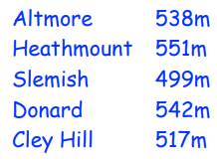
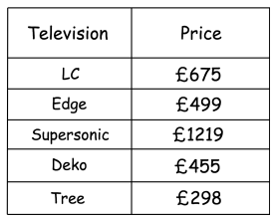
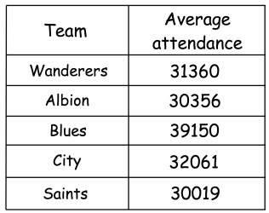
4. Shown below are the heights of five hills. | List the hills in order of size, starting with the largest.
5. The table shows the prices of five televisions | Write down the televisions in order of price. Start with the cheapest television.
6. The table below shows the average attendance for five football teams last season | Write down the teams in order of average attendance. Start with the highest
Notes:
Answers

Slide 4
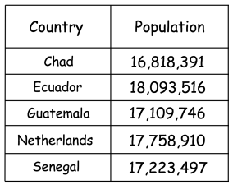
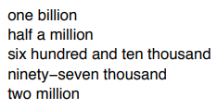
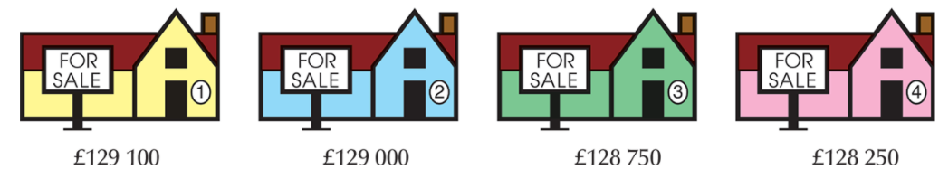
7. Here are the populations of five countries in 2022 | Arrange the countries in order of population, starting with the smallest.
8. Arrange these numbers in ascending order.
9. An estate agent advertises the following houses.
(a)Which house is the cheapest?
(b)Which house is the most expensive?
(c) George has just enough money to buy the cheapest house. How much more money would he need to buy the most expensive house?
Notes:
Answers

Slide 5

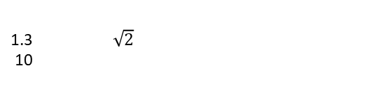
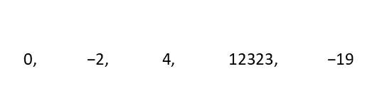


Ordering decimals
Definition
Characteristics
A decimal is a number that is not whole, as it lies between whole numbers.
Consists of a whole and a fraction part.
In a decimal, the fractional part is written as digits after a point rather than a fraction.
The whole and fraction parts are separated by a point called the decimal point.
Can be terminating or recurring.
Decimal
Examples
$$38$$
$$1\frac{2}{3}$$
Non - Examples
0.2 123.43 0.278
1.87 12.7657 10000.1 $0.\dot{6}$
4.0000000001 80.987654321 -3.43 $3.\dot{2} 3.\dot{2}746\dot{4}$
$$\frac{4}{5}$$
1.3 $\sqrt{2}$
10
1 × 20 = 20 | so 1 and 20 are both factors of 20
2 × 10 = 20 | so 2 and 10 are both factors of 20
4 × 5 = 20 | so 4 and 5 are both factors of 20
240
$$\text{0, −2, 4, 12323, −19}$$
 | For the following questions, use this number line to help you place the numbers in ascending order
Steps | 4.23, 4.52, 4.33 | 4.91, 4.21, 4.67 | 4.17, 4.68, 4.24
Look at the place value of the leftmost digit. Write down the number with the largest place value.
If any have the same place value, look at the digit to the right and write down the number with the lowest value. Repeat until all numbers have been ordered.
For the following questions, list the numbers in ascending order.
Example 7 - I do…
Example 8 – We do…
Example 9 – You do…

Slide 6
Independent Practice
15. For the following questions, list the numbers in ascending order.
a) 0.93, 0.96, 0.91, 0.99, 0.95
b) 1.47, 1.49, 1.40, 1.43, 1.41
c) 2.36, 2.38, 2.39, 2.33, 2.37
d) 0.16, 0.18, 0.12, 0.11, 0.15
e) 3.45, 3.52, 3.41, 3.58, 3.49
f) 4.67, 4.82, 4.46, 4.29, 4.65
g) 1.56, 1.78, 1.11, 1.03, 1.43
h) 2.64, 2.03, 2.17, 2.80, 2.54
 | For the following questions, use this number line to help you place the numbers in ascending order
Steps | 4.12, 4.21, 4.01 | 4.12, 4.31, 4.14 | 4.03, 4.31, 4.23
Look at the place value of the leftmost digit. Write down the number with the largest place value.
If any have the same place value, look at the digit to the right and write down the number with the highest value. Repeat until all numbers have been ordered.
Example 7 - I do…
For the following questions, list the numbers in descending order.
Example 10 - I do…
Example 11 – We do…
Example 12 – You do…

Slide 7
Arrange the numbers below in ascending order:
Steps | 4.35, 4.31, 4.6 | 4.7, 4.52, 4.59 | 4.4, 4.52, 4.51
Look at the place value of the leftmost digit. Write down the number with the largest place value.
If any have the same place value, look at the digit to the right and write down the number with the lowest value. Repeat until all numbers have been ordered.
Example 13 - I do…
Example 14 – We do…
Example 15 – You do…
Independent Practice
17. For the following questions, list the numbers in ascending order.
a) 6.34, 6.45, 6.3, 6.52, 6.28
b) 1.23, 1.3, 1.45, 1.09, 1.42
c) 3.6, 3.91, 3.07, 3.55, 3.9
d) 2.91, 2.2, 2.78, 2.01, 2.55
e) 1.9, 2.04, 2.3, 2.22, 1.98
f) 0.65, 0.5, 0.7, 0.06, 0.49
g) 3.99, 3.95, 4.01, 4.03, 3.9

Slide 8
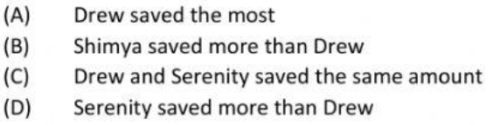
For the following questions, list the numbers in descending order.
Steps | 6.4, 6.72, 6.31, 7.5, 7 | 6.42, 6.87, 6, 7.1, 7.65 | 8, 7.4, 6.35, 7.35, 6.2
Look at the place value of the leftmost digit. Write down the number with the largest place value.
If any have the same place value, look at the digit to the right and write down the number with the largest value. Repeat until all numbers have been ordered.
Example 16 - I do…
Example 17 – We do…
Example 18 – You do…
Independent Practice
18. For the following questions, list the numbers in descending order.
a) 3.99, 3.95, 4.01, 4.03, 3.9
b) 0.78, 0.68, 0.79, 0.77, 0.7
c) 2.65, 2.69, 2.6, 2.72, 2.62
19.
a) Jadin weighs 96.5 pounds, Aaron weighs 89.09 pounds and Kavonia weighs 90.06 pounds. Order the students using their weights from heaviest to lightest.
b) Drew, Serenity and Shimya each save a portion of their £20 pocket money each week. Serenity saves 0.9, Shimya saves 0.75, and Drew saves 0.8 of pocket money. Circle the correct statement.

Slide 9
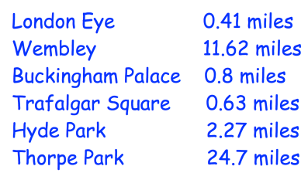
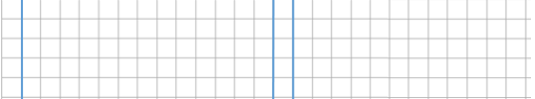
20. For the following questions, arrange the temperatures from highest to lowest.
a) 11 °C, 10.8°C, 12.3 °C, 15 °C, 12.7 °C | b) 8.5 °C, 0.7 °C, 3 °C, 0.9 °C, 6 °C, 1.3 °C, 5.1°C
21. For the following questions, order the amounts of money from lowest to highest.
a) £6.74, £10, £1.99, £8, £3.30, £2 | b) 80p, £1, £0.09, 23p, £2.75, £0.82, £20
24. The distance of various landmarks from Big Ben are listed below. | Arrange the landmarks in order, from closest to furthest.

Slide 10
Ordering negative numbers
Definition
Characteristics
Negative numbers are numbers that represent values that are less than zero. They show things like temperatures below zero, debts and losses.
Negative numbers have a negative sign (-) in front of them, telling us they are less than zero. They are smaller than positive numbers. They are like the opposite of positive numbers. Positive numbers are on the right side of zero, and negative numbers are on the left side.
When comparing negative numbers, the one with the smaller distance from zero is considered greater. For example, -3 is greater than -5 because -3 is closer to zero.
Examples
Negative Number
Non - Examples
Temperature: If the temperature drops below zero, like -10 degrees Celsius, it means it's colder than zero degrees.
Debt: When you owe money, the amount is represented by a negative number. For example, if you owe £100, it can be written as -£100.
-3 -10 -0.5 -⅔ -632.456
Positive Numbers: Positive numbers are greater than zero and are not negative.
Zero: Zero is not positive or negative.
5 0 2.5 ⅔ 200 45.67
For the following questions, list the numbers in ascending order.
Steps | -9, 9, 0, -1, -7 | -9, 9, 0, -11, -7 | -9, 9, 0, 11, -7
Look for the negative furthest from zero. This is the smallest number.
Repeat this step until all negatives have been ordered, then order the positives.
Example 25 - I do…
Example 26 – We do…
Example 27 – You do…

Slide 11
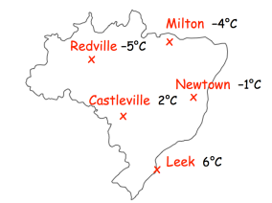
Independent Practice
28. For the following questions, list the numbers in ascending order.
a) -3, 13, 3, -2, 0, 1
b) -3, -1, 3, -7, 0, 14
c) -13, -1, 3, -7, 10, 14
d) 13, -11, 3, -72, 104, -4
e) 3, −5, 1, 0, −2, 4
f) −1, 8, −5, 2, −9, −4, 3
g) −1, −7, −2, 5, −6, 1
h) 10, −7, −3, 5, −9, −2, −12
29. Arrange the following temperatures in order, from lowest to highest.
a) -8°C, 12°C, 9°C, -15°C, 11°C, -7°C, 2°C
b) 2°C, −5°C, 4°C, 8°C, −3°C, 1°C, −7°C
c) 5°C, −3°C, 11°C, 9°C, −14°C, 21°C, −1°C
c) 19°C, -92°C, 93°C, -91°C, −29°C, 21°C, 0°C
 | 4. Arrange the towns in order of temperature, starting with the lowest.

Slide 12
Subtopic 2a – Rounding to nearest integer, or decimal places
LEARNING OUTCOME: To round numbers to the nearest 10, 100, 1000.
Objectives:
Keywords:
Approximation
Integer
Round
To round a whole number.
To round numbers to the nearest 10, 100,1000.
To answer worded questions about rounding.
Definition
Characteristics
Numbers round up or down depending on the value they are closer to.
If a number is exactly halfway between the two values it could round to, it rounds up
The process of finding an approximation for a number to a given accuracy
Examples
Rounding
Non - Examples
1853 = 1850 to the nearest 10
1853 = 1900 to the nearest 100
1853 = 2000 to the nearest 1000
18.53 = 19 to the nearest integer
1853 ≠ 50 to the nearest 10
35 ≠ 30 to the nearest 10
18.53 ≠ 19.00 to the nearest integer
18.68 ≠ 18.6 to one decimal place.
 | Example 1 – I do… | Example 2 – We do… | Example 3 – You do…
Steps | Round these numbers to the nearest 10. | Round these numbers to the nearest 10. | Round these numbers to the nearest 10.
Identify the value you’re rounding to above and the value below. Is it closer to the value above or the value below? | 53 125 | 67 165 | 86 135
 | Round these numbers to the nearest 100. | Round these numbers to the nearest 100. | Round these numbers to the nearest 100.
 | 489 1350 | 821 1150 | 676 1492
 | Round 143,981 to the nearest: | Round 25,865 to the nearest: | Round 162,912 to the nearest:
 | 100 1000 | 100 1000 | 100 1000
Notes:
https://www.bbc.co.uk/bitesize/guides/zscq6yc/revision/1

Slide 13
1. Round each number to the nearest 10:
32 |  | e) 59 |  | i) 845
b) 67 |  | f) 238 |  | j) 1628
c) 71 |  | g) 312 |  | k) 502
d) 24 |  | h) 333 |  | l) 7555
2. Round each number below to the nearest 100 a) 245 = _______ (nearest 100) b) 7620 = ______ (nearest 100) c) 4801 = _______ (nearest 100) d) 9450 = ______ (nearest 100)
e) 1234 = _______ (nearest 100) f) 1254 = _______ (nearest 100)
g) 12540 = _______ (nearest 100) h) 12054 = _______ (nearest 100)
i) 4708 = _______ (nearest 100) j) 3902.8 = _______ (nearest 100)
k) 76.34 = _______ (nearest 100) l) 24 = _______ (nearest 100)
3. Now round each number in question 3 to the nearest 1000 a) 4382 = _______ (nearest 1000) b) 43820 = _______ (nearest 1000)
c) 43280 = _______ (nearest 1000) d) 40328 = _______(nearest 1000)
e) 1234 = _______ (nearest 1000) f) 5839 = _______ (nearest 1000)
g) 12540 = _______ (nearest 1000) h) 12054 = _______ (nearest 1000)
i) 104,708 = _______ (nearest 1000) j) 3902.8 = _______ (nearest 1000)
k) 706.34 = _______ (nearest 1000) l) 324 = _______ (nearest 1000)

Slide 14
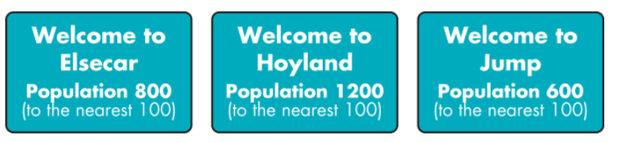
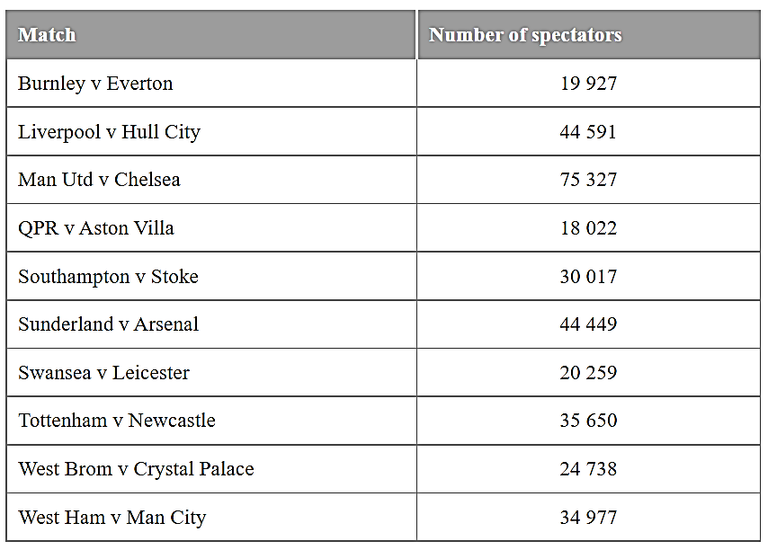
4. Round these numbers to the given degree of accuracy
Number | Rounded to the nearest 10 | Rounded to the nearest 100 | Rounded to the nearest 1000
6432
9256
40039
4555.9
5. Look at these signs.
Which of these sentences could be true? Which must be false?
There are 789 people living in Elsecar
b) There are 1278 people living in Hoyland
c) There are 550 people living in Jump
d) There are 843 people living in Elsecar
e) There are 1205 people living in Hoyland
f) There are 650 people living in Jump
6. The table shows the numbers of spectators in the crowds at ten Premier Division games on a weekend in October 2014.
Which match had the largest crowd?
b) Which had the smallest crowd?
c) Round all the numbers to the nearest 1000.
d) Round all the numbers to the nearest 100.

Slide 15
Rounding to decimal places
LEARNING OUTCOME: To be able to round to one, two and three decimal places.
Objectives:
Keywords:
Rounding
Integer
Decimal
To round decimal numbers to a given number of decimal places.
To able to answer worded questions involving rounding.
Definition
Characteristics
Approximating a number to the closest number of given accuracy.
After rounding the number will have the amount of decimal places that it has been rounded to.
Examples
Rounding to decimal places
Non - Examples
1.75 rounded to one decimal place is 1.8
It gets rounded up and there is only one digit after the point (in the tenths column)
5.98 rounded to one decimal place is not 6.
It is 6.0. You must include the tenths digit.
Rounding to the one decimal place (nearest tenth) using number lines
Example 1 - I do…
Steps:
Place the number on the number line.
See if the number is closer to the lower value or the upper value.
Write down what the number rounds to.
Round 2.35 to the one decimal place
2.35
2.3
2.4
2.35 rounded to 1 decimal place is
Example 2 - We do…
Example 3 - You do…
Round 4.12 to the one decimal place
Round 5.78 to the one decimal place
4.1
4.2
5.7
5.8
4.12 rounded to 1 decimal place is
rounded to 1 decimal place is

Slide 16
Independent Practice
1. Round each number to one decimal place
a) 0.45
b) 2.48
c) 3.48
0.4
0.5
2.4
2.5
3.4
3.5
rounded to the 1 decimal place is
rounded to the 1 decimal place is
rounded to the 1 decimal place is
d) 5.58
e) 7.69
f) 9.21
5.5
5.6
7.6
7.7
9.2
9.3
rounded to the 1 decimal place is
rounded to the 1 decimal place is
rounded to the 1 decimal place is
g) 9.91
h) 10.66
i) 12.76
9.9
10.0
10.6
10.7
12.7
12.8
rounded to the 1 decimal place is
rounded to the 1 decimal place is
rounded to the 1 decimal place is
j) 23.53
k) 24.61
l) 38.72
23.5
23.6
24.6
24.7
38.7
38.8
rounded to the 1 decimal place is
rounded to the 1 decimal place is
rounded to the 1 decimal place is
m) 50.59
n) 75.78
o) 84.58
50.5
50.6
75.7
75.8
84.5
84.6
rounded to the 1 decimal place is
rounded to the 1 decimal place is
rounded to the 1 decimal place is

Slide 17
Rounding without using a number line
Example 4 - I do…
Example 5 - We do…
Example 6 – You do…
Steps | Round each number to one decimal place.
1) Draw a line between the value in the tenths column and the hundredths column.
2) Underline the number in the hundredths column.
3) If it is below 5, then the tenths column stays the same.
4) If it is 5 or above, then the tenths column is rounded up
Round 0.58 to one decimal place
0 . 5 | 8
Round 2.92 to one decimal place
Round 3.69 to one decimal place
Round 2.21 to one decimal place
2 . 2 | 1
Round 5.05 to one decimal place
Round 4.78 to one decimal place
Independent Practice
2. Round each number to one decimal place.
a) 0.81
b) 0.85
c) 1.85
d) 1.89
e) 2.05
f) 2.65
g) 3.84
h) 3.88
i) 4.67
j) 4.81
k) 5.23
l) 5.28
m) 6.74
n) 6.89
o) 7.49
p) 7.52
q) 7.68
r) 7.91
Example 7 - I do…
Example 8 - We do…
Example 9 – You do…
Steps | Round each number to one decimal place.
1) Draw a line between the value in the tenths column and the hundredths column.
2) Underline the number in the hundredths column.
3) If it is below 5, then the tenths column stays the same.
4) If it is 5 or above, then the tenths column is rounded up.
Round 1.95 to one decimal place
1 . 9 | 5
Round 3.96 to one decimal place
Round 4.98 to one decimal place
Round 2.99 to one decimal place
2 . 9 | 9
Round 5.95 to one decimal place
Round 7.97 to one decimal place

Slide 18
Independent Practice
3. Round each number to one decimal place.
a) 0.95
b) 1.95
c) 2.95
d) 3.92
e) 3.94
f) 3.95
g) 4.99
h) 9.95
i) 5.97
j) 5.99
k) 7.96
l) 8.99
m) 9.98
n) 10.98
o) 12.97
p) 21.98
q) 27.99
r) 36.99
Rounding to two decimal places
Example 16 - I do…
Steps:
Place the number on the number line.
See if the number is closer to the lower value or the upper value.
Write down what the number rounds to.
Round 2.353 to two decimal places
2.353
2.35
2.36
2.353 rounded to 2 decimal places is
Example 17 - We do…
Example 18 - You do…
Round 3.129 to two decimal places
Round 4.782 to two decimal places
3.12
3.13
4.78
4.79
3.129 rounded to 2 decimal places is
rounded to 2 decimal places is

Slide 19
Independent Practice
6. Round each number to two decimal places.
a) 0.435
b) 2.483
c) 3.883
0.43
0.44
2.48
2.49
3.88
2.89
rounded to the 2 decimal places is
rounded to the 2 decimal places is
rounded to the 2 decimal places is
d) 5.582
e) 7.682
f) 9.214
5.58
5.59
7.68
7.69
9.21
9.22
rounded to the 2 decimal places is
rounded to the 2 decimal places is
rounded to the 2 decimal places is
Example 19 - I do…
Example 20 - We do…
Example 21 – You do…
Steps | Round each number to two decimal places.
1) Draw a line between the value in the hundredths column and the thousandths column.
2) Underline the number in the thousandths column.
3) If it is below 5, then the hundredths column stays the same.
4) If it is 5 or above, then the hundredths column is rounded up
Round 3.588 to two decimal places.
3 . 5 8 | 8
Round 4.491 to two decimal places.
Round 7.693 to two decimal places.
Round 19.997 to two decimal places.
Round 67.592 to two decimal places.
Round 71.395 to two decimal places.
Independent Practice
7. Round each number to two decimal places.
a) 1.594
b) 1.954
c) 1.495
d) 2.495
e) 2.954
f) 2.495
g) 3.159
h) 3.259
i) 3.952
j) 4.952
k) 7.925
l) 7.239

Slide 20
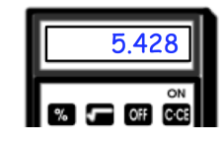



9. Round each number to one, two and three decimal places.
Number | 1 decimal place | 2 decimal places | 3 decimal places
1. 0.1234
2. 0.2345
3. 0.3456
4. 0.4567
5. 0.04567
6. 0.40567
7. 0.45067
8. 9.45067
9. 9.45967
10. 9.95967
10. Round each number to the decimal places specified.
a) $7.74026$
b) $13.49581$
c) $9.990099009$
1dp
2dp
3dp
4dp
1dp
2dp
3dp
4dp
5dp
6dp
7dp
8dp
11: 51.26% of the people living in a town are female. Round this figure to one decimal place.
12. Walter has worked out a calculation on a calculator.
Shown on the calculator is the answer. (a) Round the answer to one decimal place (b) Round the answer to two decimal places

Slide 21
Subtopic 9 – Rounding to significant figures
Subtopic 2b – Rounding to Significant Figures
LEARNING OUTCOME: To round decimals to a given degree of accuracy.
Objectives:
To be able to identify significant figures.
To be able to round to a given number of decimal places.
To be able to round to a given number of significant figures.
Keywords:
significant figure
Approximate
estimate
Definition
Characteristics
Numbers round up or down depending on the value they are closer to (and exactly halfway between rounds up).
The first significant figure is the first non-zero digit. All following digits count as significant.
The process of finding an approximation for a number to a given accuracy
Examples
Rounding
Non - Examples
170.8 = 200 to 1 significant figure
107.8 = 110 to 2 significant figures
0.01079 = 0.0108 to 3 significant figures
0.01038 = 0.010 to 2 significant figures
Identifying significant figures.
Example 1 - I do…
Example 2 - We do…
Example 3 – You do…
Identify which digit is the significant figure | Identify which digit is the significant figure
1) Identify the position of the first non-zero digit, starting from the left.
2) Count until you reach the required digit.
Which significant figure is the 5?
560
0.05
0.00475
Which significant figure is the 6?
260
0.61
0.00672
Which significant figure is the 4?
425
0.041
0.07041
21

Slide 22
Independent Practice
1. Which significant figure is the four?
a) 450
b) 540
c) 5400
d) 50400
e) 50040
f) 54000
g) 0.4
h) 0.504
i) 0.0504
j) 0.05043
k) 1.5004
l) 0.0050042
Rounding to one significant figure.
Example 4 - I do…
Example 5 - We do…
Example 6 – You do…
Steps | Round to 1 significant figure
1) Draw a line between the first and second significant figure.
2) If the 2nd significant figure is 5 or above, the 1st significant figure rounds up.
3) If the 2nd significant figure is 4 or below, the 1st significant figure stays the same.
Round 36 to one significant figure
3 | 6
Round 49 to one significant figure
Round 75 to one significant figure
Round 453 to one significant figure
4 | 5 3
Round 4353 to one significant figure
Round 4531 to one significant figure
Independent Practice
2. Round each number to 1 significant figure.
a) 12
b) 15
c) 24
d) 27
e) 35
f) 39
g) 390
h) 395
i) 401
j) 450
k) 570
l) 690
m) 1200
n) 1500
o) 1005
p) 1050
q) 2950
r) 2095
s) 2495
t) 2945
u) 3059
v) 3595
w) 8099
x) 6499

Slide 23
y) 12100
z) 46100
a1) 65400
b1) 95120
c1) 96290
d1) 863000
Example 7 - I do…
Example 8 - We do…
Example 9 – You do…
Steps | Round to 1 significant figure
1) Draw a line between the first and second significant figure.
2) If the 2nd significant figure is 5 or above, the 1st significant figure rounds up.
3) If the 2nd significant figure is 4 or below, the 1st significant figure stays the same.
Round 1.25 to one significant figure
1 | 2 5
Round 3.95 to one significant figure
Round 7.75 to one significant figure
Round 17.68 to one significant figure
1 | 7 . 6 8
Round 15.98 to one significant figure
Round 17.59 to one significant figure
Independent Practice
3. Round each number to 1 significant figure.
a) 2.4
b) 2.5
c) 2.9
d) 3.9
e) 4.9
f) 4.91
g) 3.91
h) 3.95
i) 4.15
j) 4.55
k) 5.75
l) 6.76
m) 12.7
n) 15.1
o) 15.5
p) 15.9
q) 17.5
r) 19.9
s) 24.95
t) 29.45
u) 30.59
v) 35.95
w) 80.99
x) 64.99

Slide 24
Example 10 - I do…
Example 11 - We do…
Example 12 – You do…
Steps | Round to 1 significant figure
1) Draw a line between the first and second significant figure.
2) If the 2nd significant figure is 5 or above, the 1st significant figure rounds up.
3) If the 2nd significant figure is 4 or below, the 1st significant figure stays the same.
Round 0.25 to one significant figure
0 . 2 | 5
Round 0.31 to one significant figure
Round 0.75 to one significant figure
Round 0.0378 to one significant figure
0 . 0 3 | 7 8
Round 0.0392 to one significant figure
Round 0.0431 to one significant figure
Independent Practice
4. Round each number to 1 significant figure.
a) 0.41
b) 0.45
c) 0.49
d) 0.55
e) 0.59
f) 0.91
g) 0.95
h) 0.905
i) 0.951
j) 0.091
k) 0.095
l) 0.059
m) 0.0591
n) 0.0045
o) 0.0054
p) 0.00501
q) 0.0505
r) 0.005905
Rounding to two significant figures.
Example 13 - I do…
Example 14 - We do…
Example 15 – You do…
Steps | Round to 2 significant figures
1) Draw a line between the second and third significant figure.
2) If the 3rd significant figure is 5 or above, the 2nd significant figure rounds up.
3) If the 3rd significant figure is 4 or below, the 2nd significant figure stays the same.
Round 467 to two significant figures
4 6 | 7
Round 4670 to two significant figures
Round 7592 to two significant figures

Slide 25
Independent Practice
5. Round each number to 2 significant figures.
a) 314
b) 351
c) 392
d) 395
e) 405
f) 455
g) 1200
h) 1250
i) 1255
j) 2359
k) 4395
l) 5095
m) 7059
n) 8679
o) 12500
p) 13550
q) 14609
r) 156500
Example 16 - I do…
Example 17 - We do…
Example 18 – You do…
Steps | Round to 2 significant figures
1) Draw a line between the second and third significant figure.
2) If the 3rd significant figure is 5 or above, the 2nd significant figure rounds up.
3) If the 3rd significant figure is 4 or below, the 2nd significant figure stays the same.
Round 1.25 to two significant figures
1 . 2 | 5
Round 3.98 to two significant figures
Round 7.75 to two significant figures
Round 17.68 to two significant figures
1 7 | 6 8
Round 13.98 to two significant figures
Round 27.95 to two significant figures
Independent Practice
6. Round each number to 2 significant figures.
a) 1.31
b) 1.35
c) 2.39
d) 7.93
e) 9.19
f) 9.99
g) 10.5
h) 10.9
i) 12.5
j) 12.55
k) 12.99
l) 15.37

Slide 26
m) 16.37
n) 19.79
o) 19.59
p) 24.95
q) 24.955
r) 25.095
s) 126.4
t) 196.4
u) 125.5
v) 135.5
w) 135.55
x) 195.89
Example 19 - I do…
Example 20 - We do…
Example 21 – You do…
Steps | Round to 2 significant figures
1) Draw a line between the second and third significant figure.
2) If the 3rd significant figure is 5 or above, the 2nd significant figure rounds up.
3) If the 3rd significant figure is 4 or below, the 2nd significant figure stays the same.
Round 0.253 to two significant figures
0 . 2 5 | 3
Round 0.937 to two significant figures
Round 0.751 to two significant figures
Round 0.0685 to two significant figures
0 . 0 6 8 5
Round 0.0817 to two significant figures
Round 0.0952 to two significant figures
Independent Practice
7. Round each number to 2 significant figures.
a) 0.315
b) 0.351
c) 0.359
d) 0.399
e) 0.193
f) 0.1931
g) 0.1913
h) 0.1935
i) 0.1953
j) 0.1955
k) 0.1995
l) 0.1999
m) 0.0156
n) 0.0165
o) 0.0564
p) 0.0565
q) 0.0599
r) 0.009559

Slide 27
Rounding to three significant figures.
Example 22 - I do…
Example 23 - We do…
Example 24 – You do…
Steps | Round to 3 significant figures
1) Draw a line between the third and forth significant figure.
2) If the 4th significant figure is 5 or above, the 3rd significant figure rounds up.
3) If the 4th significant figure is 4 or below, the 3rd significant figure stays the same.
Round 16740 to three significant figures
1 6 7 4 0
Round 24520 to three significant figures
Round 26380 to three significant figures
Round 1.674 to three significant figures
1 . 6 7 4
Round 3.065 to three significant figures
Round 7.507 to three significant figures
Round 0.1674 to three significant figures
0 . 1 6 7 4
Round 0.8295 to three significant figures
Round 0.7975 to three significant figures
Independent Practice
8. Round each number to 3 significant figures.
a) 15560
b) 15780
c) 16790
d) 16850
e) 16855
f) 16899
g) 24689
h) 25789
i) 18649
j) 2.359
k) 4.395
l) 5.095
m) 7.059
n) 8.679
o) 12.59
p) 13.554
q) 14.609
r) 156.53

Slide 28
s) 126.49
t) 196.45
u) 125.505
v) 139.509
w) 199.502
x) 199.99
y) 0.573
z) 0.4675
a1) 0.0574
b1) 0.05866
c1) 0.09095
d1) 0.01999
9. Complete the following table by rounding each number to 1, 2 and 3 significant figures
 | 1sf | 2sf | 3sf
123.456
144.402
8888.888
437.3946
987.654
3 809 830.492
1.98043
4.80808
99.009900
10. In an election 43.86% of people voted for a candidate. Round this figure to one significant figure
11. 32641 people watch a rugby match between Italy and Argentina. Round this number to 2 significant figures.

Slide 29

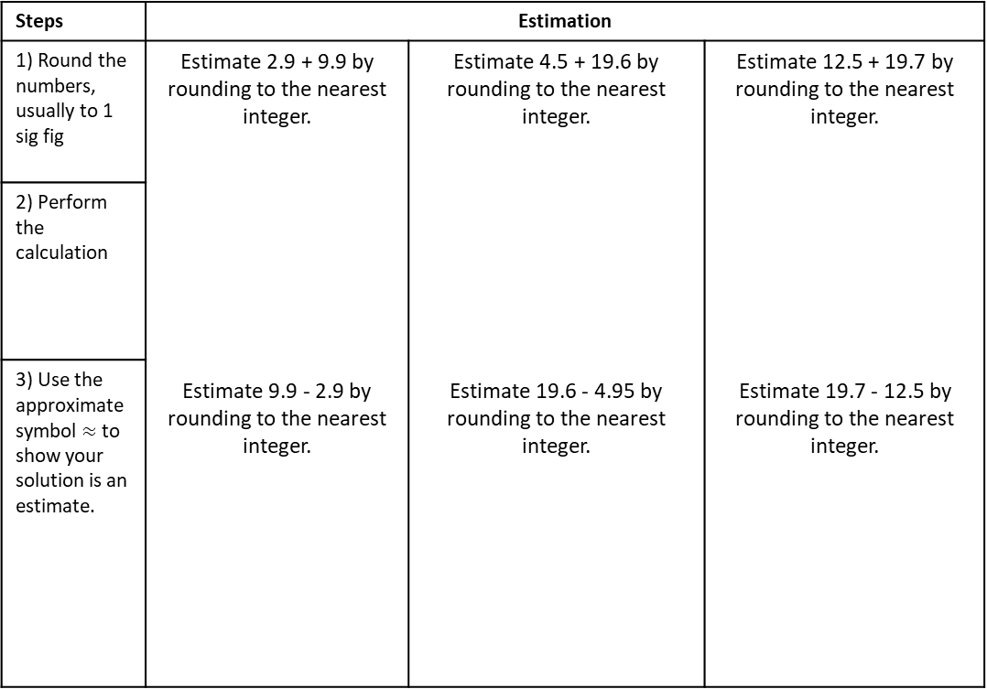
Subtopic 3 – Estimation
LEARNING OUTCOME: To use estimation to solve problems.
Objectives:
To be able to use rounding to estimate calculations.
To estimate with powers and roots.
Keywords:
significant figure
Approximate
estimate
Definition
Characteristics
Calculating an approximate answer to a calculation by rounding the numbers used in the calculation prior to carrying the calculation.
Typically, number used in the calculation will be rounded to 1 significant figure
The result of the calculation will be close to the real answer
Examples
Estimating (a calculation)
Non - Examples
27 × 432 ≈ 30 × 400
27 × 432 =
$$\frac{73.8×23.93}{0.345}≈\frac{70×20}{0.3}$$
 | 400 | 30 | 2
20 | 8000 | 600 | 40
7 | 2800 | 210 | 14
Example 1 - I do…
Example 2 - We do…
Example 3 – You do…
Steps | Estimation
1) Round the numbers, usually to 1 sig fig | Estimate 2.9 + 9.9 by rounding to the nearest integer. Estimate 9.9 - 2.9 by rounding to the nearest integer. | Estimate 4.5 + 19.6 by rounding to the nearest integer. Estimate 19.6 - 4.95 by rounding to the nearest integer. | Estimate 12.5 + 19.7 by rounding to the nearest integer. Estimate 19.7 - 12.5 by rounding to the nearest integer.
2) Perform the calculation
3) Use the approximate symbol $≈$ to show your solution is an estimate.
29

Slide 30
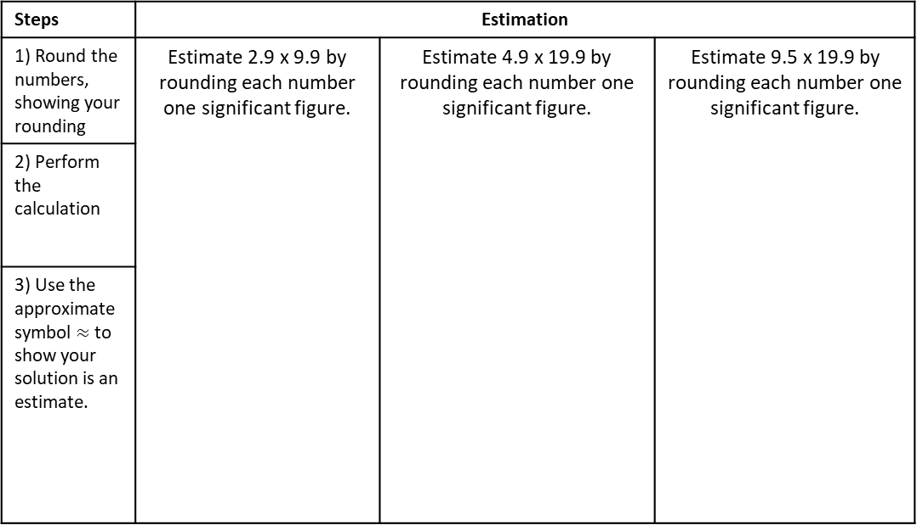
Independent Practice
1. Estimate the answer to each by rounding each
number to the nearest integer
a) 0.99 + 17.9
b) 0.99 + 19.9
c) 0.99 + 25.9
d) 1.95 + 17.9
e) 2.95 + 17.95
f) 17.9 - 0.9
g) 17.95 - 0.9
h) 16.95 - 2.9
i) 16.95 – 5.8
j) 16.95 – 5.85
Example 4 - I do…
Example 5 - We do…
Example 6 – You do…
Steps | Estimation
1) Round the numbers, showing your rounding | Estimate 2.9 x 9.9 by rounding each number one significant figure. | Estimate 4.9 x 19.9 by rounding each number one significant figure. | Estimate 9.5 x 19.9 by rounding each number one significant figure.
2) Perform the calculation
3) Use the approximate symbol $≈$ to show your solution is an estimate.
30

Slide 31
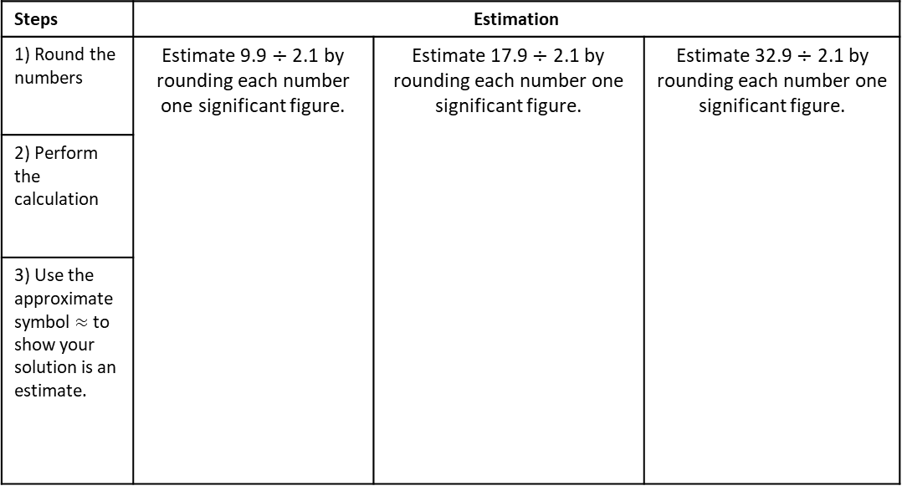
Independent Practice
2. Estimate the answer to each by rounding each
number to one significant figure.
a) 0.99 x 1.99
b) 1.95 x 9.9
c) 2.99 x 9.5
d) 4.95 x 9.98
e) 4.95 x 9.99
f) 9.5 x 11.9
g) 9.5 x 14.9
h) 15.1 x 9.5
Example 7 - I do…
Example 8 - We do…
Example 9 – You do…
Steps | Estimation
1) Round the numbers | Estimate 9.9 $÷$ 2.1 by rounding each number one significant figure. | Estimate 17.9 $÷$ 2.1 by rounding each number one significant figure. | Estimate 32.9 $÷$ 2.1 by rounding each number one significant figure.
2) Perform the calculation
3) Use the approximate symbol $≈$ to show your solution is an estimate.

Slide 32












Independent Practice
3. Estimate the answer to each by rounding each
number to one significant figure.
a) 7.9 $÷$ 1.99
b) 9.9 $÷$ 1.99
c) 9.9 $÷$ 4.95
d) 19.5 $÷$ 1.99
e) 19.5 $÷$ 4.05
f) 19.5 $÷$ 5.19
g) 24.9 $÷$ 4.99
h) 34.9 $÷$ 6.4
g) 104.5 $÷$ 4.9
h) 212.6 $÷$17.8
i) 147.2 $÷$ 9.76
j) 134.9 $÷$ 45.9

Slide 33



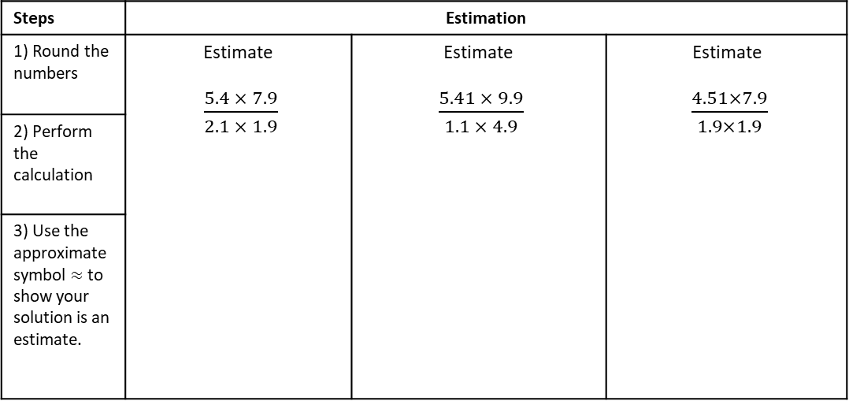





Example 10 - I do…
Example 11 - We do…
Example 12 – You do…
Steps | Estimation
1) Round the numbers | Estimate $\frac{5.4 × 7.9}{2.1 × 1.9}$ | Estimate $\frac{5.41 × 9.9}{1.1 × 4.9}$ | Estimate $\frac{4.51×7.9}{1.9×1.9}$
2) Perform the calculation
3) Use the approximate symbol $≈$ to show your solution is an estimate.
Independent Practice
4. Estimate the answer to each by rounding each
number to one significant figure.
a) $\frac{4.8 ×15}{10.5}$
b) $\frac{4.8 ×15}{15.5}$
c) $\frac{4.8 ×2.3}{2.3}$
d) $\frac{48 × 23}{23}$
e) $\frac{48 × 23}{2.3 ×4.8}$
f) $\frac{48 × 23}{2.35 ×4.87}$
g) $\frac{48 × 23}{23.5 ×4.87}$
h) $\frac{4.8 × 2.3}{2.35 ×4.87}$

Slide 34






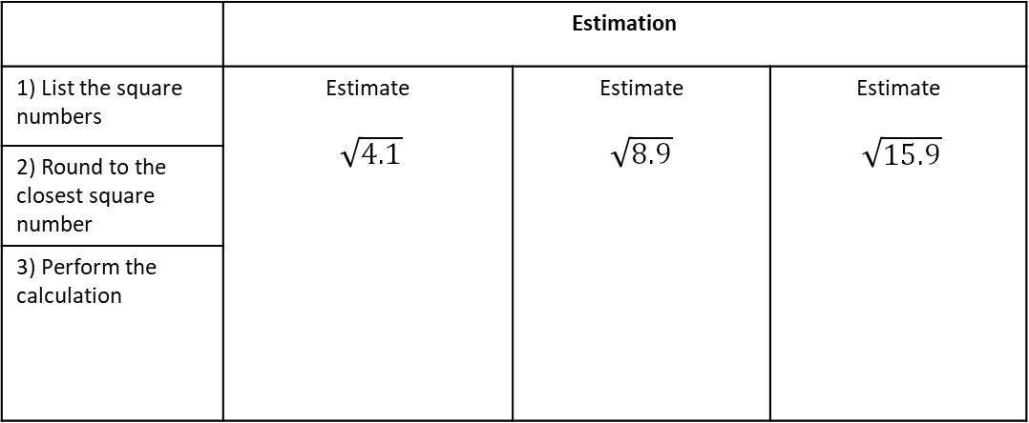









Example 13 - I do…
Example 14 - We do…
Example 15 – You do…
 | Estimation
1) List the square numbers | Estimate $\sqrt{4.1}$ | Estimate $\sqrt{8.9}$ | Estimate $\sqrt{15.9}$
2) Round to the closest square number
3) Perform the calculation
Independent Practice
5. Estimate the answer to each by rounding each
number to the nearest integer
a) $\sqrt{0.9}$
b) $\sqrt{1.1}$
c) $\sqrt{3.8}$
d) $\sqrt{4.4}$
e) $\sqrt{9.2}$
f) $\sqrt{24.9}$
g) $\sqrt{36.3}$
h) $\sqrt{48.9}$
i) $\sqrt{80.94}$
j) $\sqrt{63.952}$
f) $\sqrt{25.18}$
g) $\sqrt{99.99}$
h) $\sqrt{101.37}$
i) $\sqrt{143.94}$
j) $\sqrt{144.0062}$

Slide 35



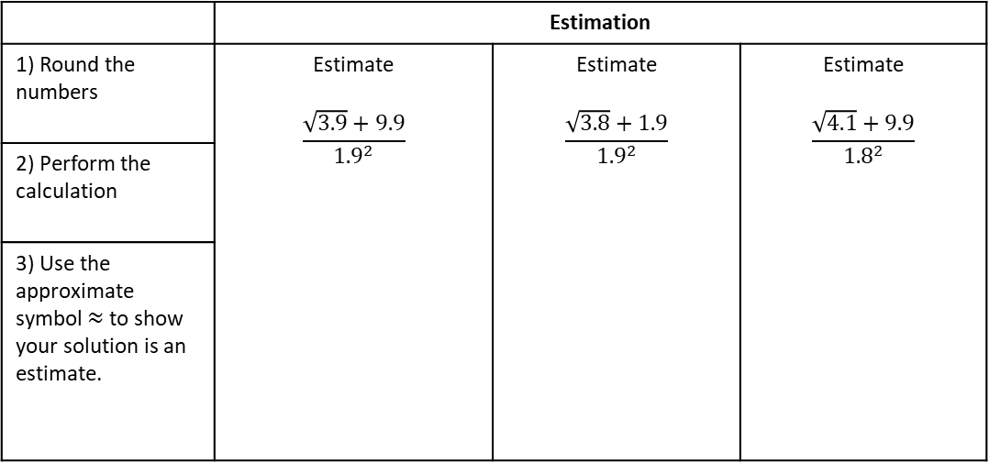





Multi-step Estimation
Example 19 - I do…
Example 20 - We do…
Example 21 – You do…
 | Estimation
1) Round the numbers | Estimate $$\frac{\sqrt{3.9}+9.9}{{1.9}^{2}}$$ | Estimate $$\frac{\sqrt{3.8}+1.9}{{1.9}^{2}}$$ | Estimate $$\frac{\sqrt{4.1}+9.9}{{1.8}^{2}}$$
2) Perform the calculation
3) Use the approximate symbol $≈$ to show your solution is an estimate.
Independent Practice
6. Estimate by rounding
a) $\frac{\sqrt{9.1} + 9.9}{{0.9}^{2}}$
b)$\frac{\sqrt{8.9} + 9.9}{{0.9}^{2}}$
c)$\frac{\sqrt{8.9} +10.1}{{1.1}^{2}}$
d) $\frac{9.5 + \sqrt{8.8}}{{1.1}^{2}}$
f) $\frac{{1.9}^{2} × 9.9}{\sqrt{4.1}}$
g)$\frac{{2.9}^{2} × 9.9}{\sqrt{4.1}}$
h)$\frac{4.1 ×{4.1}^{2}}{7.9}$
i) $\frac{{5.9}^{2} × \sqrt{4.1}}{11.9}$

Slide 36
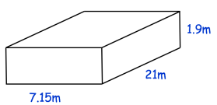
8. Estimate the total cost of 32 printers at £198 each and 58 ink cartridges at £31.15 each.
9. In a cinema there are 28 rows and in each row there are 22 seats. Each ticket costs £8.10 Work out an estimate for the total income from the ticket sales
10. Lauren is given two job offers Job A: £785 a week Job B: £1950 a month Which job is offering the greatest pay?
11. A buzzer beeps every 1,111 seconds. Work out an estimate for the number of times the buzzer beeps in 1 week.
12. Andrew is going to fill an empty swimming pool. Andrew fills the swimming pool with water at a constant rate of 2.1 litres per second.
Given 1m³ = 1000 litres, estimate how long it takes to fill the pool
13. Estimate $\frac{\sqrt[3]{124} ×{3.9}^{2}}{\sqrt{15.9} × 1.9}$

Slide 37
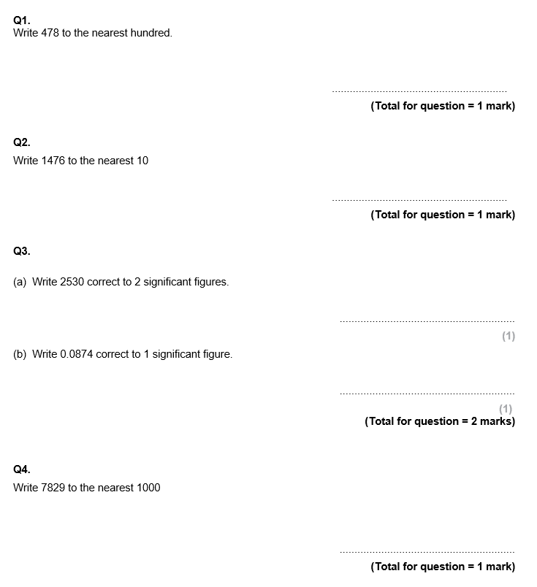
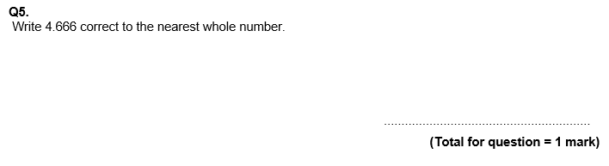
GCSE Questions

Slide 38
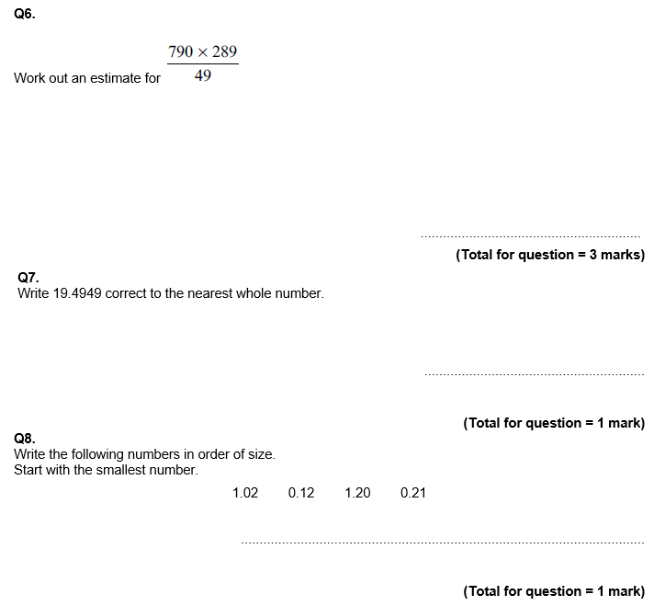
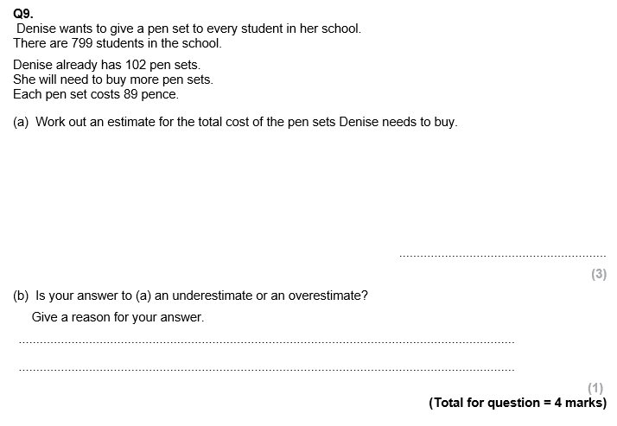

Slide 39
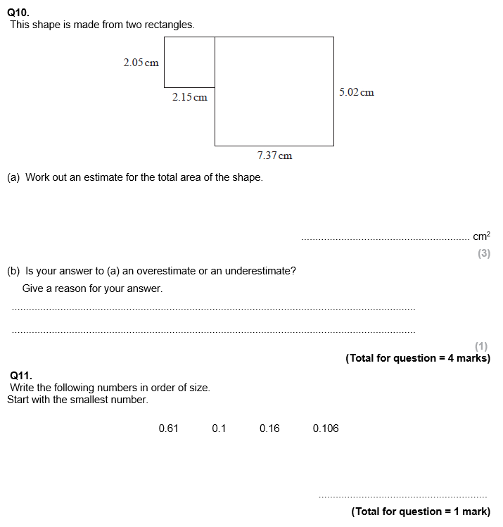
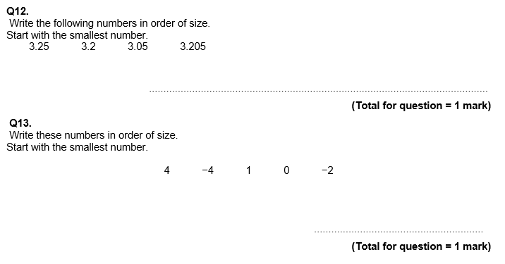

Slide 40
